Slide 1


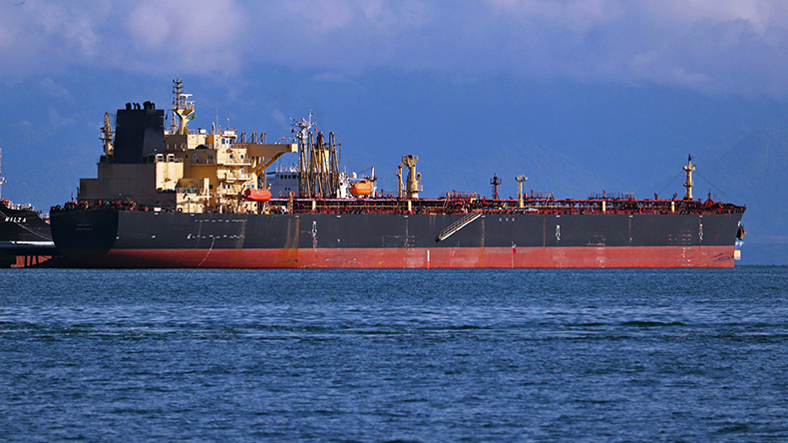
Problem Statement ID - 1655
Problem Statement Title - Detecting Oil Spills at Marine Environment Automatic Identification System (AIS) and satellite datasets
Team ID - 6182
Team Name - INNOTECHIES

Slide 2
Introduction
To detect oil spills, create a system that combines automatic identification system (ais) data with satellite images. monitor vessels for unusual behavior and check for oil spills using satellite data for early detection and fast response.
Problem:
The solution combines satellite images to detect oil spills and AIS data to track ships and identify possible sources. An alert system provides quick updates to authorities, enabling faster action to reduce pollution and protect marine ecosystems effectively
Solution:

Slide 3
AIS- Automatic Identification System
Path deviation:
Path Deviation means when something, like a ship, moves off its expected or normal route. LSTM (Long Short-Term Memory) is a model that looks at patterns in time-based data, helping to predict future paths and find unusual movements.
Kalman’s filter
algorithm:
The Kalman Filter is an algorithm that estimates the state of a system (like a ship’s position) by combining previous data with new measurements, even when there’s uncertainty. It helps predict the next position and detect deviations or anomalies in movement.

Slide 4
AIS- Automatic Identification System
To detect anomalies in a ship's movement, the Haversine formula calculates the distance between
two consecutive positions. If the distance exceeds a predefined threshold,
it indicates an anomaly, such as an unexpected or abnormal deviation in the ship's path or speed.
Distance:
A collision between ships can be detected by calculating the distance between them using the Haversine formula. If the ships are within a dangerous threshold distance and moving towards each other, it suggests a potential collision
Collision:

Slide 5
Satellite
Satellite image processing:
After detecting anomalies in ship movements using AIS data, we use satellite imagery for further analysis. The API processes these images with DeepLabv3, a state-of-the-art deep learning model designed for semantic image segmentation. DeepLabv3 helps identify and segment specific features in the images, such as oil spills or other maritime anomalies, by accurately classifying individual pixels. This integration of AIS data and image processing allows for comprehensive, real-time monitoring, enabling quick identification and response to environmental threats in marine environments.

Slide 6
Satellite
Accurate Oil Spill Detection with Satellite Data:
After finding unusual ship movements, we use satellite images to check for oil spills. Using a tool called Rasterio, we can read and work with these images. We also analyze the image’s histogram, which shows how pixel values are distributed. This helps us spot patterns like oil spills more accurately and make better decisions quickly

Slide 7
Alert System
Alert System for Environmental Protection:
Once an oil spill is confirmed, we use SMTP (Simple Mail Transfer Protocol) to send alerts through email to nearby ports and ships. This ensures immediate communication with relevant authorities and vessels, facilitating quicker responses and coordinated actions to minimize the environmental impact of the spill.
Conclusion:
By combining AIS data with satellite datasets, our system efficiently detects oil spills in the marine environment.This approach ensures timely identification of anomalies, enabling quick alerts to nearby ships and ports, thus facilitating prompt responses to minimize environmental damage and ensure maritime safety.

